Slide 1


akka.net

Slide 2
Service
Classic system
BLL
Component/Object
DAO
EF
Entitet

Slide 3
Server

Slide 4
CPU

Slide 6
Moore’s Law
We can no longer build faster processors Instead, we stack them next to eachother and call them ”cores”

Slide 7
Service
Request

Slide 8
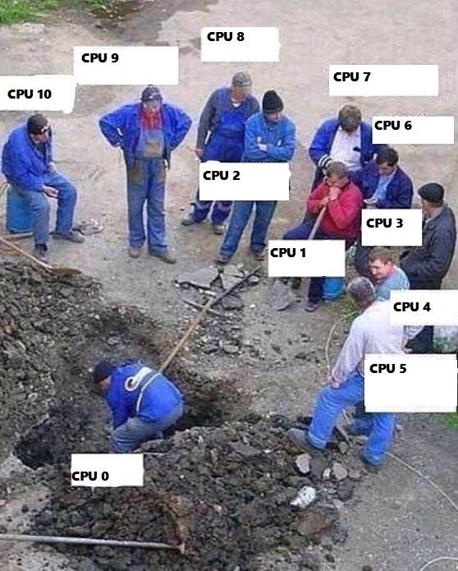
Service
Request

Slide 9
Service
Request
Multithreading Multithreaded systems let us utilize more than one core

Slide 10
Service
Request
Multithreading Flertrådade system låter oss nyttja fler än en kärna samtidigt

Slide 11
Scale out When one CPU is no longer enough

Slide 12

Classic technologies
Scale up:
Parallel Linq TPL – async await
Threads
Scale out:
WCF Web API
MSMQ
Elasticity:
Complex, Slow and Annoying

Slide 13


akka.net
Scale up:
Akka.Actor
Scale out:
Akka.Remote
Elasticity:
Akka.Cluster

Slide 14

Scale up and out are essentially the same
That is; we want to execute code ”somewhere”, on a core, on a machine, in a cluster.
Why should we have to resort to different technologies to accomplish the same thing?

Slide 15
Scale up and out are essentially the same
That is; we want to execute code ”somewhere”, on a core, on a machine, in a cluster.
Why should we have to resort to different technologies to accomplish the same thing?

Slide 16







Internet of Things

Slide 17
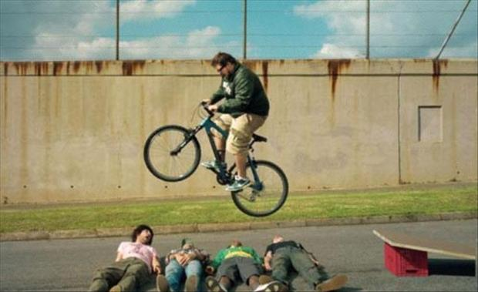
Felhantering i Java, C# och C

Slide 18

Konsument 1
Konsument 2
Komponent

Slide 19
Webbsite
Affärslogik
Komponent

Slide 20
Service-tekniker
Slut på bönor!
Fyll på bönor
Lägg i pengar
Jag
Kaffemaskin
Lägg i mer pengar
Slut på bönor!
Får kaffe

Slide 21
Supervisor
Application error
Manage failures
Request
Client
Service
Validation error
Response

Slide 22
Supervise
Alla actors har en supervisor som bestämmer vad som ska ske när ett fel uppstår.
En supervisor kan välja att:
Tvinga en omstart
Stoppa
Ignorera felet
Eskalera felet till sin egen supervisor

Slide 23
/
”Root Guardian”
Error Kernel
/user
/system
”Guardian”
”System Guardian”
User actor
Hierarchy
System actor
Hierarchy

Slide 24
/
Error Kernel
/user
/system
99.9999999% uptime ~0.03 sekunder downtime per år
OneForOne supervisor
/a1
/a2
AllForOne supervisor
/b1
/b1
/b2
/b3
/b3
/c1
/c2
/c3
/c4
/c5

Slide 25
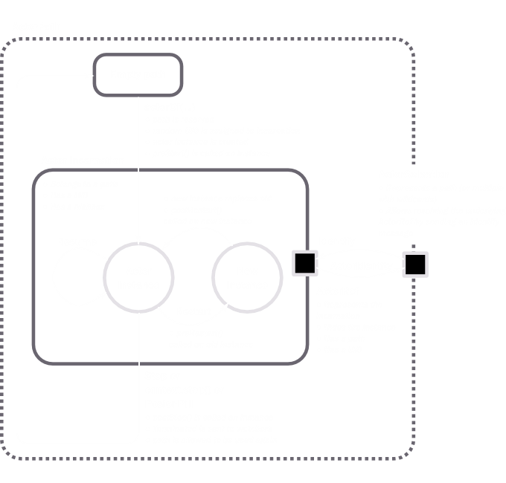

Slide 26

Actor Model
Tre axiom:
Send - Kan skicka meddelanden till andra actors
Create - Kan skapa nya actors
Become - Kan ändra hur nästkommande meddelande ska hanteras
”An island of sanity in a sea of concurrency”
”Shared nothing”, ”Black box”
”Location transparent”, ”Distributable by design”

Slide 27
OOP vs. Actor Model
OOP
Actor Model
Behavior
Behavior
Stateful
Stateful
Synchronous method calls
Asynchronous message passing
Why Actors?? The synchronous model has worked nicely for 60 years!?

Slide 28
Moore’s Law
We can no longer build faster processors Instead, we stack them next to eachother and call them ”cores”

Slide 29

Event-driven thread
Actor
ActorRef
Mailbox
Transport
ActorRef
Behavior
State
Supervision
Children

Slide 30
Actor Model
Actor1
Actor1
Actor2
Actor3
Actor4
Actor1
Thread Pool
Actor2
Actor3
Actor1
Actor2
Actor2
Actor4
Actor4
Actor3
Time
Cheaper than threads, not the same context switching

Slide 31
Footprint?
En actor kostar endast CPU-tid när den processar ett meddelande.
Minnesmässigt beror på vilken implementation av actor model man använder men under Akka/Akka.NET:
Ca 2.5 miljoner actors per gigabyte minne på JVM. (inte riktigt där än på .NET, vi jobbar på det)

Slide 32
Actor Model
Vad kan en actor användas till?
Alternativ till trådning
Som ett objekt/komponent
Som en service/singleton
Routing av meddelande, t.ex. consistent hash eller round robin
Entitet / Aggregatroot a’la CQRS
State machines

Slide 33
Actor Model
Produkter baserade på actor model:
Erlang
Facebook WhatsApp (Erlang)
RabbitMQ
CouchDB (Erlang)
LinkedIn.com (Akka)
Walmart.com (Akka)

Slide 34
Akka.Actor

Slide 35
Demo – Bygg din första actor
ActorSystem
ReceiveActor
HandleActor
Props
ActorRef

Slide 36
Akka.Remote

Slide 38
System 1
System 2

Slide 39
Demo – Aktivera remoting
RemoteActorRefProvider
FluentConfiguration
ActorSelection

Slide 40
Demo – Remote Deployment
Deployment configuration
RemoteDaemon

Slide 41
Akka.Routing

Slide 42
Routers
A router delegates messages to other ”routee” actors
Group routers, Pool routers
BroadcastRouter
RoundRobinRouter
ConsistentHashRouter
ScatterGatherFirstCompletedRouter
SmallestMailboxRouter
TailChoppingRouter

Slide 43
BroadcastRouter
Notifies all ”routees”
2
1
Routee1
2
1
Router
2
1
Routee2
2
1
Routee3

Slide 44
RoundRobinRouter
4
1
Routee1
Scale up!
4
3
2
1
Router
2
Routee2
3
Routee3
.. Or down!

Slide 45
RoundRobinRouter
Routee1
Scale out!
Remote1
Router
Routee2
Scale up!
Routee3
Routee1
Router
Remote2
Router
Routee2
Routee3
Routee1
Remote3
Router
Routee2
Routee3

Slide 46
ConsistentHashRouter
Same ”hash index”
A
M
Routee1
X
A
Y
M
Router
Y
Routee2
X
Routee3
Affinity between hash index and routee

Slide 47
ConsistentHashRouter
OCR: 789
OCR: 123
OCR:456
OCR: 123
Betalning
Stoppa
Router
Skapa
Skapa
…
…
…
…

Slide 48
ConsistentHashRouter
Löser race conditions
OCR: 123
OCR: 123
Stoppa
Skapa
Routee1
…
…
OCR: 789
OCR: 123
OCR:456
OCR: 123
OCR:456
Router
Routee2
Betalning
Stoppa
Skapa
Skapa
Skapa
…
…
…
…
…
OCR: 789
Betalning
Routee3
…

Slide 49
ScatterGatherFirstCompletedRouter
?
Routee1
Sender
?
Router
?
Routee2
!
?
Routee3
En fråga distribueras till alla workers.
Första svaret returneras till avsändaren
Konceptuellt samma som TPL Task.WaitAny(tasks)

Slide 50
Demo – Använd routers
RoundRobin
ConsistentHash

Slide 51
Become
Become eller hotswap innebär att en actor kan byta beteende när den tar emot ett visst meddelande.
I Akka.NET sker detta via metoderna .Become samt .Unbecome
Praktiskt när man skapar state machines.

Slide 52
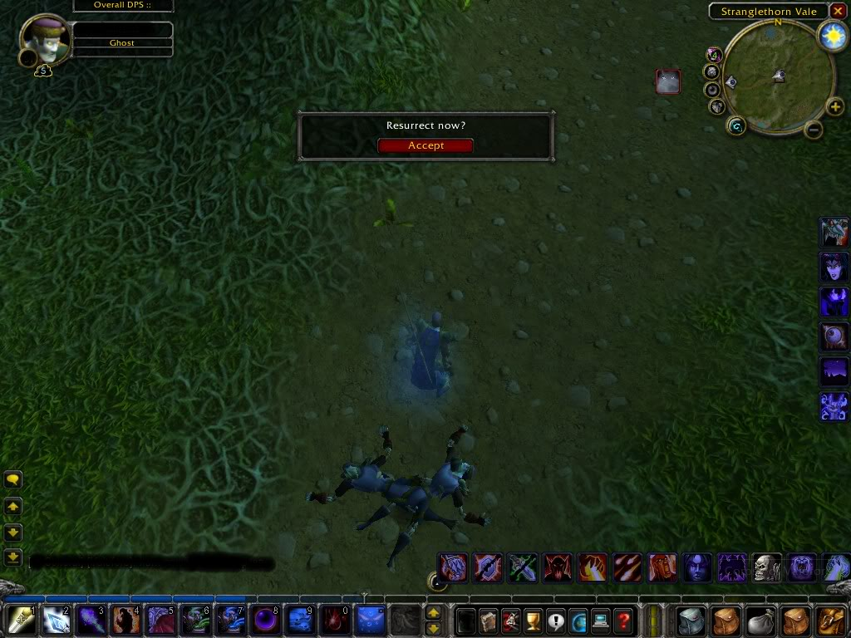
Private void Alive(){
…//annan kod
if (this.hitpoints <= 0)
this.Become(Dead);
…
}
private void Dead(){
Receive<Resurrect>(_ => {
this.hitpoints = this.maxHitpoints;
this.Become(Alive);
});
}

Slide 53
Dependency Injection
Container kan användas lokalt
Använd service locator för remote deployed

Slide 54
Actor System

Slide 56
Race condition
if (account1.Balance > amount)
{
account1.Withdraw(amount)
account2.Deposit(amount)
}
Thread 1
Thread 2

Slide 57
The End

Slide 58
ActorSystem
akka.tcp://sys@host:8080/user
akka.tcp://sys@host:8080/user
.Path
Guardian supervisor ”user”
.Self
ActorContext
.Context
Actor class Guardian
.Parent
.Parent
akka.tcp://sys@host:8080/user/parent
.Path
Some supervisor ”parent”
.Self
ActorContext
.Context
Actor class MyParent
.Parent
.Children
akka.tcp://sys@host:8080/user/parent/child
.Path
Some supervisor ”child”
.Self
ActorContext
.Context
Actor class MyChild
ActorPath
ActorRef
ActorCell
Actor

Slide 59
Event-driven thread
Actor
ActorRef
Transport
ActorRef
5
Mailbox
1
2
3
4
Transport
Behavior
State
SupervisorStrategy
Children

Slide 60
/
Error Kernel
/user
/system
User actor
Hierarchy
System actor
Hierarchy

Slide 61
BroadcastRouter
2
1
Routee1
2
1
Router
2
1
Routee2
2
1
Routee3

Slide 62
RoundRobinRouter
4
1
Routee1
4
3
2
1
Router
2
Routee2
3
Routee3

Slide 63
Actor1
Actor1
Actor2
Thread Pool
Actor2
Actor3
Actor1
Actor4
Actor4

Slide 64
Core
Thread1
Thread2
Thread3
Thread1
Thread2
Thread3
Thread1
Thread2
Thread3

Slide 65
Vad är akka.net ?
Akka.NET är ett toolkit för programmering enligt Actor Model.
Ursprungligen skrivet i Scala för JVM. Portat till CLR (snart även Mono)
Syftet är att erbjuda utvecklare en högre abstraktionsnivå för att skriva feltoleranta, skalbara och samtidiga(concurrent) system.

Slide 66

Inga problem!
X 1 000 000

Slide 67
..uh oh!
Minnesallokering
Race Conditions
Context Switching
Deadlocks
Livelocks
Svår/rörig kod – Monitor.TryEnter, WaitHandle, AutoResetEvent etc.
Felhantering?
(Blocking IO)

Slide 68
Minnesallokering
1MB på 32bit, 4MB på 64bit
…per tråd!!

Slide 69

Context Switching
Core
Thread1
Thread2
Thread3
Thread1
Thread2
Thread3
Thread1
Thread2
Thread3
Context Switch
Lagrar undan state för tråd1
Läser upp state för tråd 2

Slide 70
Alternativ?
Task Parallel Library – Tasks + C# async await
InProc
Asynkront jobb med 0 eller 1 returvärde.
Task Parallel Library – DataFlow
InProc
Asynkrona byggstenar för att skapa flöden av information.
Reactive Extensions
InProc
Filtrerar och aggregerar strömmar av data.
Parallel Linq
InProc
Partitionerar jobb i mindre delar och bearbetar parallellt.

Slide 72
What are ”Race Conditions”?
Account.Balance: 200
Thread 1 amount: 700
Thread 2 amount: 800
if (account.Balance >= amount)
{
account.Withdraw(amount)
}
Account.Balance: -500 !?
Thread 1 amount: 700
Thread 2 amount: 800
Account.Balance: 1000 Thread 1 amount: 700
Thread 2 amount: 800
Knock knock!
Race condition
Who's there?

Slide 73
public class MyActor : ReceiveActor
{ …
protected override SupervisorStrategy SupervisorStrategy()
{
return new OneForOneStrategy(
maxNumberOfRetries: 10,
duration: TimeSpan.FromSeconds(30),
decider: x =>
{
if (x is ArithmeticException)
return Directive.Resume;
else if (x is NotSupportedException)
return Directive.Stop;
else
return Directive.Restart;
});
}
}

